Slide 1
看
板
忍
者

Slide 2
KANBAN NINJA
看板 忍者
DARIUSZWOZNIAK.NET

Slide 3
Agenda
WHAT IS 看板?
看板 PRINCIPLES
Visualize
Kaizen
Limit Work in Progress
Manage Flow
SO... WHAT IS 看板?
MORE ABOUT 看板

Slide 4
WHAT IS
看板?

Slide 5
WHAT IS 看板?
+
=
kan 看 ban 板 kanban 看板
visual card visual card

Slide 6
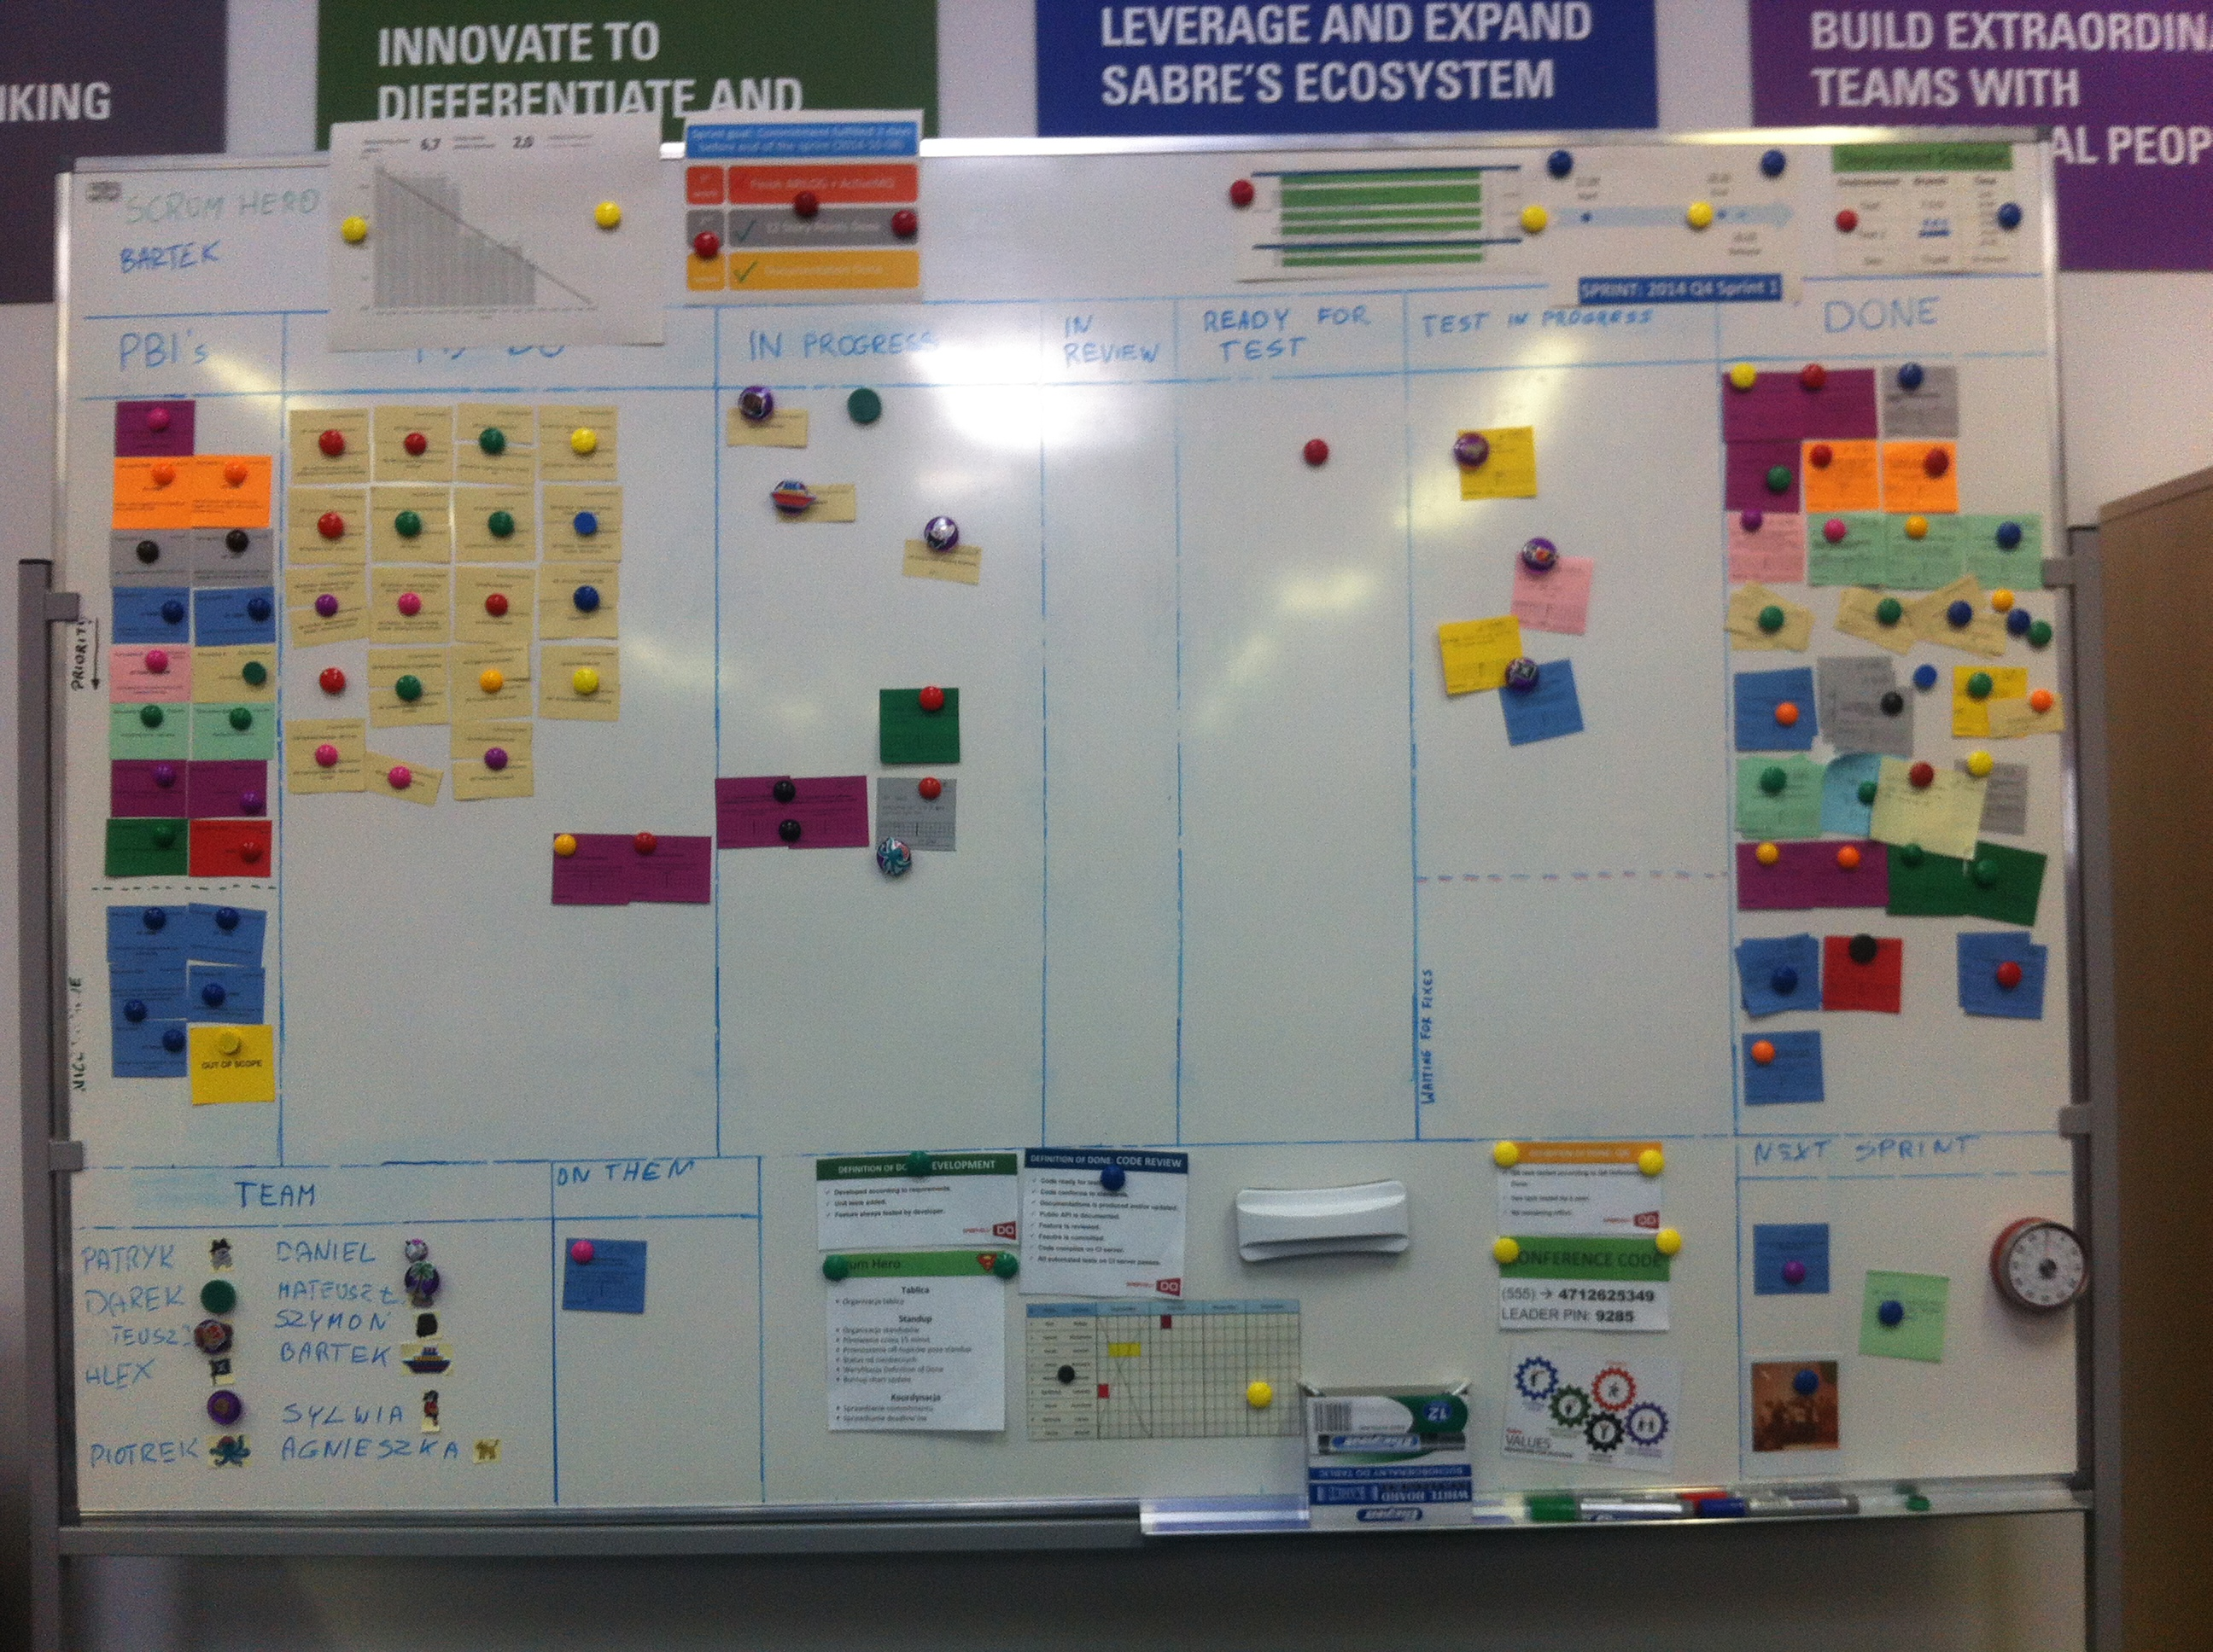
WHAT IS 看板?

Slide 7
看板 PRINCIPLES

Slide 8
KANBAN PRINCIPLES
PRINCIPLE 1 OF 3
VISUALIZE

Slide 9
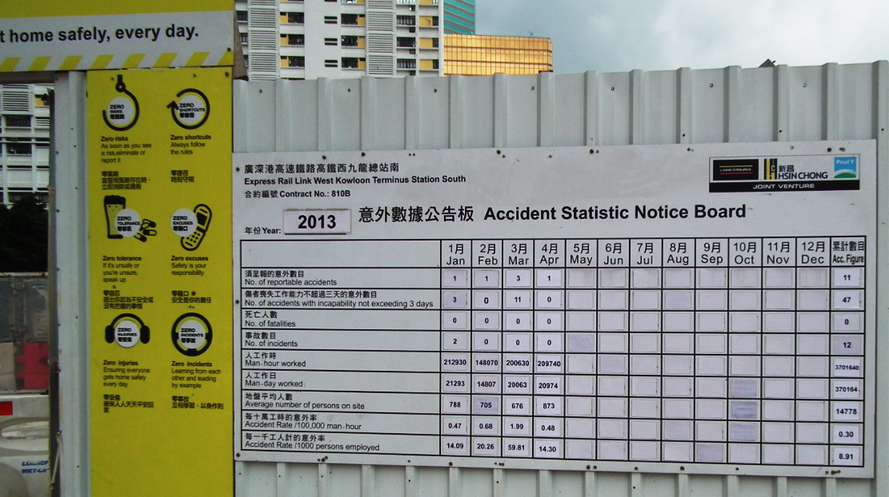
KANBAN PRINCIPLE 1 of 3: VISUALIZE

Slide 10
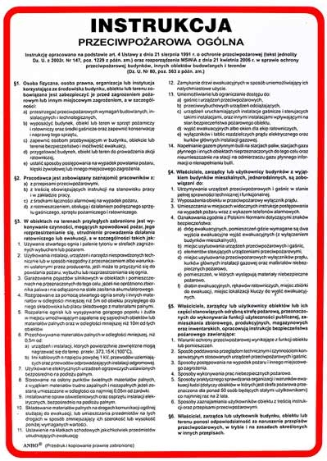
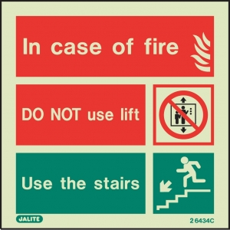
KANBAN PRINCIPLE 1 of 3: VISUALIZE
source: bhpamar.pl, 1stoptionfiresafety.com
Notes:
Sources:
http://www.bhpamar.pl/
http://www.1stoptionfiresafety.com/

Slide 11
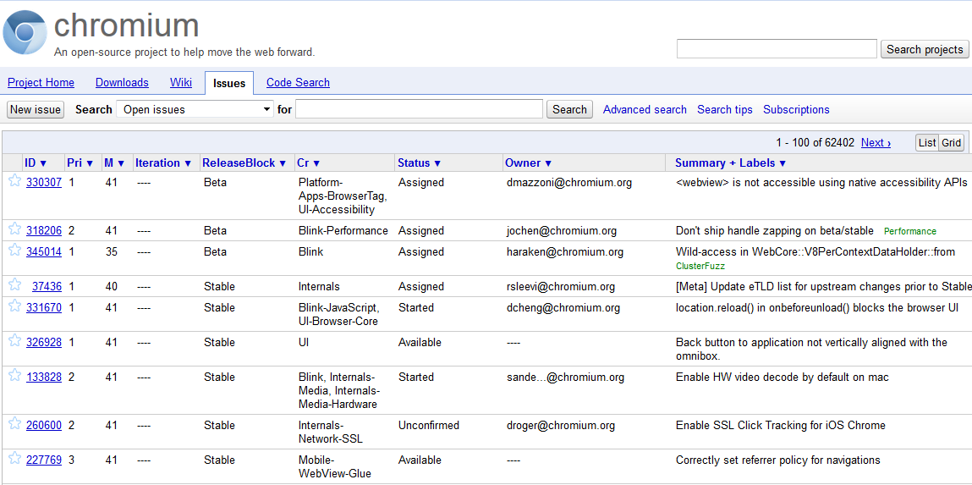
KANBAN PRINCIPLE 1 of 3: VISUALIZE
How many tasks per person?
1 – 100 of 62402
tasks. That’s a lot!
Where we are?
Lot of tasks
with priority = 1
Started.
Now, in development or in test?
Or somewhere else?
What’s the deadline?
Is this task big or small?
Started.
When?
What are the problems with the OLD GOOD PLAIN BUG list?

Slide 12
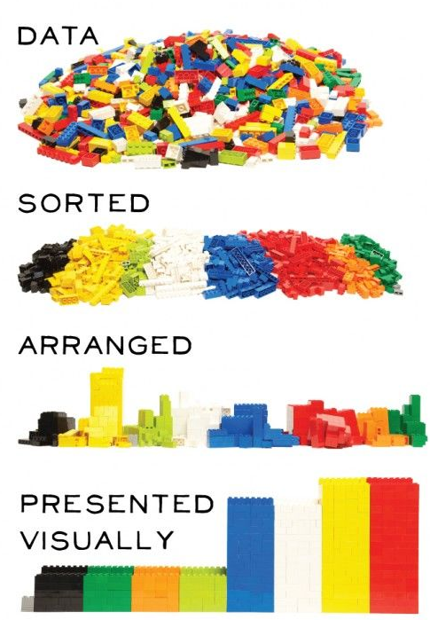
KANBAN PRINCIPLE 1 of 3: VISUALIZE
source: tbutterstudio.com
Notes:
Source: Hotbutterstudio.com

Slide 13

KANBAN PRINCIPLE 1 of 3: VISUALIZE
MOST BASIC 3-STEP WORKFLOW
to do
in progress
done

Slide 14
KANBAN PRINCIPLE 1 of 3: VISUALIZE
SAMPLE BOARD FOR DEVELOPMENT
to do
development
review
test
done

Slide 15
KANBAN PRINCIPLE 1 of 3: VISUALIZE
QUEUES
to do
development
test
done
doing
done

Slide 16
KANBAN PRINCIPLE 1 of 3: VISUALIZE
SWIMLANES
to do
in progress
done
development
tasks
infrastucture
tasks

Slide 17
KANBAN PRINCIPLE 1 of 3: VISUALIZE
PRIORITY SWIMLANE
to do
in progress
done
priority line

Slide 18


KANBAN PRINCIPLE 1 of 3: VISUALIZE
JIRA#256
Task Title
Some description and maybe details about the task itself
CARD DESIGN
Notes:
colors — classes of service
in / out time
blocked sticker
rotten banana

Slide 19
KANBAN PRINCIPLE 1 of 3: VISUALIZE
to do
in progress
done
be
creative!
kaizen
nice to
have
blocked

Slide 20
KANBAN PRINCIPLE 1 of 3: VISUALIZE
+
=
kai 改 zen 善 kaizen 改善
change good good change

Slide 21

KANBAN PRINCIPLE 1 of 3: VISUALIZE

Slide 22
KANBAN PRINCIPLES
PRINCIPLE 2 OF 3
LIMIT WORK
IN PROGRESS

Slide 23
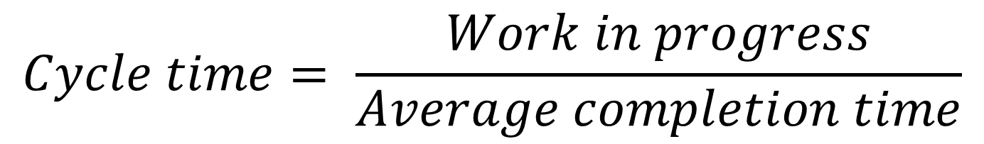
KANBAN PRINCIPLE 2 of 3: LIMIT WIP
LITTLE’S LAW
$$Cycle time= \frac{Work in progress}{Average completion time}$$

Slide 24
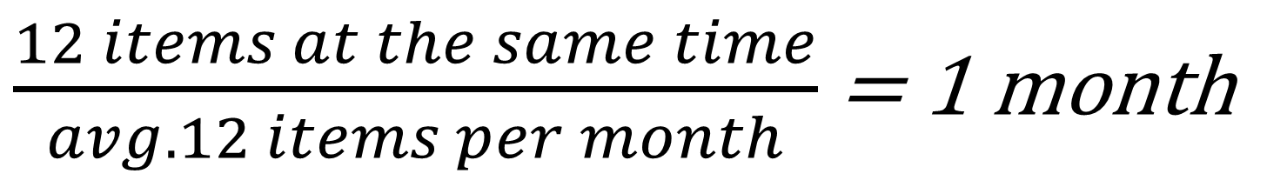
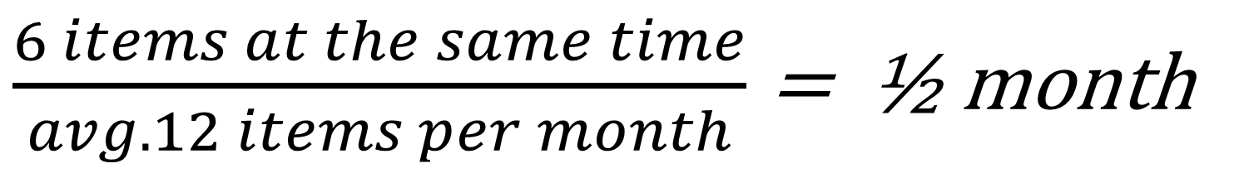
KANBAN PRINCIPLE 2 of 3: LIMIT WIP
$\frac{12 items at the same time}{avg. 12 items per month}$ = 1 month
$\frac{6 items at the same time}{avg. 12 items per month}$ = ½ month

Slide 25
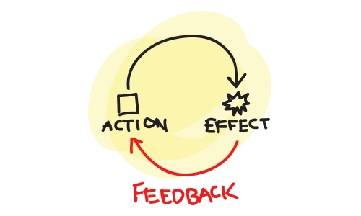
KANBAN PRINCIPLE 2 of 3: LIMIT WIP
FEEDBACK LOOP
TIME

Slide 26
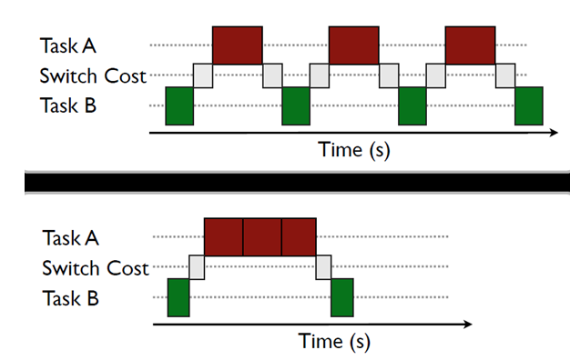
KANBAN PRINCIPLE 2 of 3: LIMIT WIP
TASK SWITCHING
Source: https://wiki.ucl.ac.uk/
Notes:
Source: https://wiki.ucl.ac.uk/download/attachments/20714555/switch%20cost.png?version=1&modificationDate=1334415571000&api=v2

Slide 27
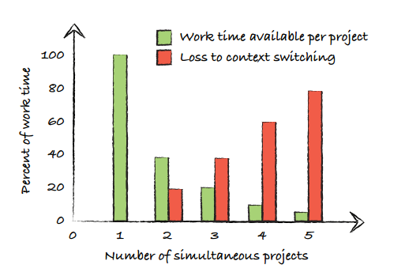
KANBAN PRINCIPLE 2 of 3: LIMIT WIP
TASK SWITCHING
With 2 things at once,
you have only 40% available time
Source: Kanban in Action, pg. 100
Notes:
Source: Kanban in Action, pg. 100
10% loss of IQ

Slide 28
KANBAN PRINCIPLE 2 of 3: LIMIT WIP
WIP LIMITS PER COLUMN
to do
in progress
done
10
4

Slide 29
KANBAN PRINCIPLES
PRINCIPLE 3 OF 3
MANAGE
FLOW

Slide 30
KANBAN PRINCIPLE 3 of 3: MANAGE FLOW
„things are produced only when needed”
just in time
no more, no less

Slide 31
KANBAN PRINCIPLE 3 of 3: MANAGE FLOW
Eliminate waste. Examples:
Partially done work
Delays
Extra (not needed) features
Task switching
Defects

Slide 32
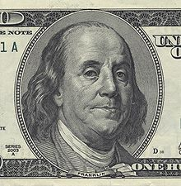
KANBAN PRINCIPLE 3 of 3: MANAGE FLOW
„avoiding unnecessary costs could be more profitable than increasing sales”

Slide 33
SO…
WHAT IS 看板?

Slide 34
SO... WHAT IS KANBAN?
BOARD
to do
in progress
done

Slide 35
SO... WHAT IS KANBAN?
3 RULES
VISUALIZE
LIMIT WIP
MANAGE FLOW

Slide 36
SO... WHAT IS KANBAN?
APPLIES TO
SCRUM
XP
LEAN
GTD!
WATERFALL :(
...

Slide 37
SO... WHAT IS KANBAN?
KANBAN IS A
META-PROCESS

Slide 38
MORE ABOUT
看板

Slide 39
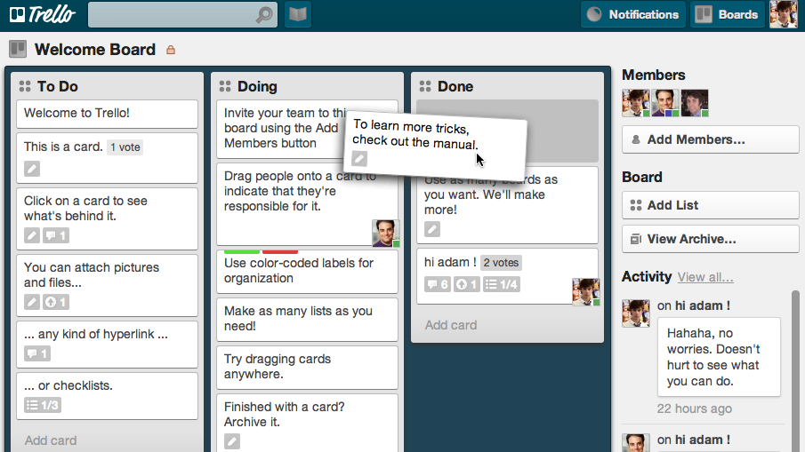
ONLINE TOOLS: TRELLO

Slide 40
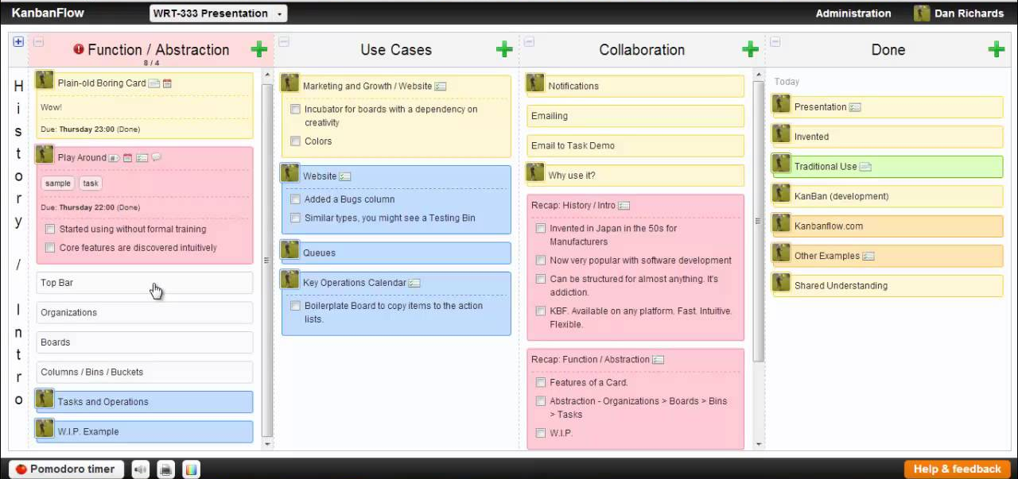
ONLINE TOOLS: KANBANFLOW

Slide 41
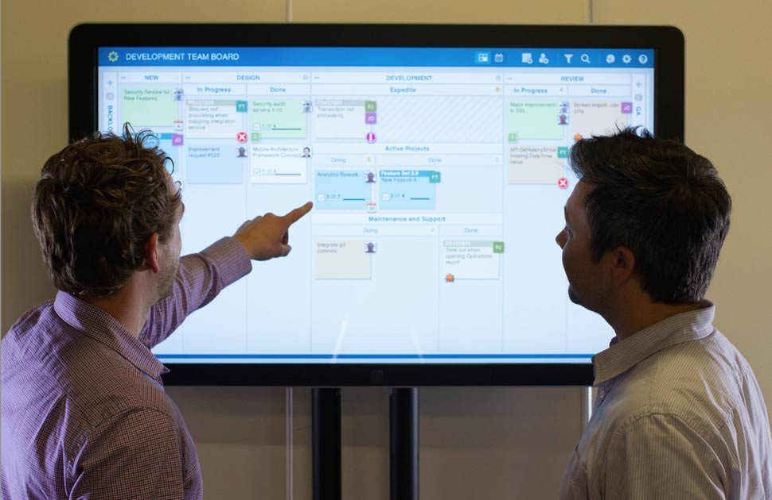
ONLINE TOOLS: LEANKIT

Slide 42


RESOURCES

Slide 43
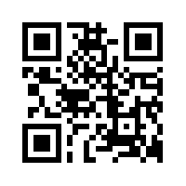
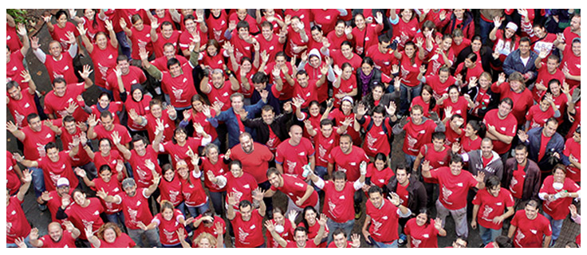
WANT TO KNOW MORE?
SABRE.PL/CAREERS

Slide 44
Q&A

Slide 45
THANK YOU
どうもありがとう
DARIUSZ.WOZNIAK@SABRE.COM
DARIUSZWOZNIAK.NET

